Slide 1
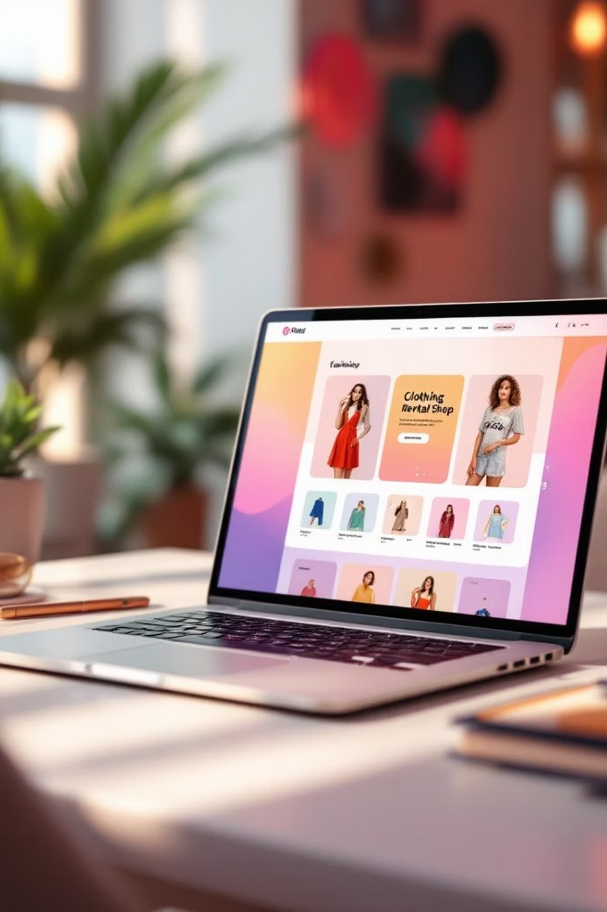
Elite Shoppy
Online Clothes Rental System
BCA Web Development Project
Mohammed Aftab Amreliwala| Udhana Citizen Commerce College|
10-03-2026

Slide 2
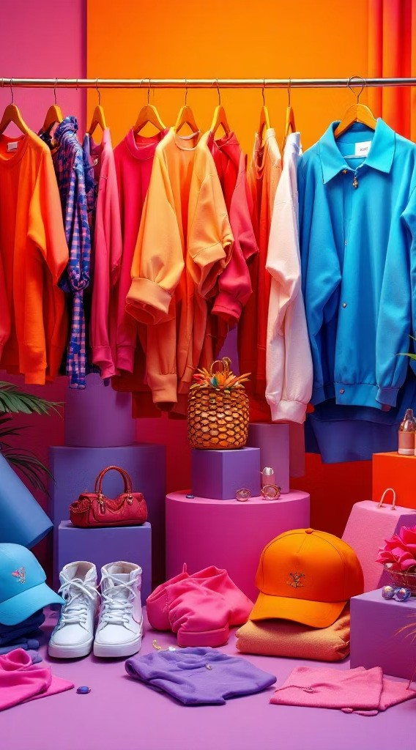




Project Introduction
Elite Shoppy is an innovative online platform that revolutionizes the way people access fashionable clothing. The system provides an affordable alternative to purchasing expensive branded outfits by enabling users to rent high-quality clothes for special occasions, events, and celebrations.
The platform connects fashion-conscious customers with premium clothing brands, allowing them to wear designer outfits without the financial commitment of ownership. This approach promotes sustainable fashion by reducing unnecessary clothing purchases while providing access to a diverse wardrobe of styles and brands.
Online Platform
Complete web-based system for browsing and renting clothes from anywhere
Fashion Rental
Access to branded, fashionable clothing at affordable rental prices
Flexible Periods
Rent clothes for specific durations tailored to your event needs

Slide 3
Project Objectives
The Elite Shoppy system was designed with clear goals that address both customer needs and operational efficiency. The platform aims to provide a seamless, user-friendly experience while maintaining robust administrative control and management capabilities.
01 02
Simplified Rental Process
Create an intuitive online clothes rental system that eliminates the complexity and inconvenience of traditional rental methods, making fashion accessible to everyone
Affordable Brand Access
Enable users to access premium branded clothing at significantly lower costs compared to purchasing, democratizing fashion for all economic backgrounds
03
04
Sustainable Fashion
Reduce unnecessary clothing purchases by promoting rental culture, contributing to environmental sustainability through clothing reuse and reduced waste
Efficient Management
Provide administrators with a comprehensive, easy-to-use system for managing inventory, orders, and customer relationships efficiently

Slide 4
System Overview
Customer Experience
The user interface is designed to be intuitive and accessible, allowing customers to browse through extensive clothing catalogs with ease. The system presents products in a visually appealing manner, with high- quality images and detailed specifications for each item.
Browse clothing collections organized by categories and brands Search and filter products based on specific criteria
View detailed product information including sizing and rental rates Select rental periods that match event schedules
Complete secure checkout process
Track order status and delivery information
Administrative Control
The admin panel provides complete oversight of all platform operations, ensuring smooth functioning and data integrity. Administrators can manage every aspect of the system from a centralized dashboard.
Full control over product catalog and inventory Customer account and order management Category, subcategory, and brand organization Real-time availability tracking
System performance monitoring
Data backup and security management

Slide 5
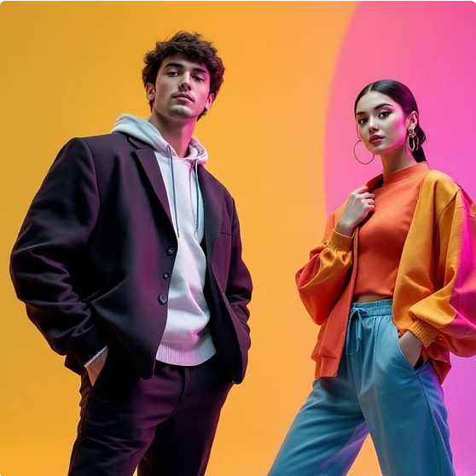
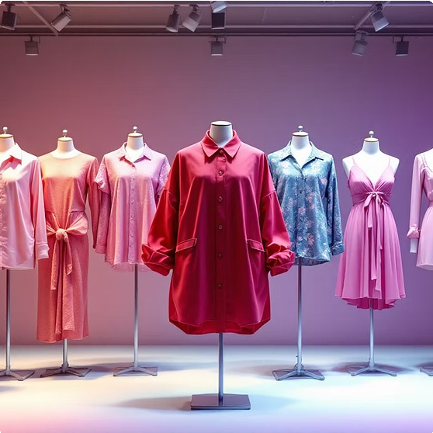


Admin Panel Modules
The administrative dashboard consists of four interconnected modules that work together to create a comprehensive clothing rental management system. Each module serves a specific purpose in organizing and presenting the product catalog.
Category
Establishes the main classification hierarchy for all clothing items in the system. Categories provide the top-level organization structure, making it easy for users to navigate to their desired clothing type.
Examples: Men, Women, Traditional Wear, Party Wear, Formal Attire, Casual Wear
Sub Category
Creates subdivisions within each main category, providing more specific classifications that help users narrow their search results efficiently.
Examples: Shirts, Jackets, Dresses, Sherwani, Kurtas, Trousers, Jeans, Skirts
Brand
Maintains a comprehensive list of clothing brands available for rental, allowing users to specifically search for their preferred designer labels.
Examples: Zara, H&M, Raymond, Louis Philippe, Armani, Gucci, Versace
Product
Represents individual clothing items available for rent, containing complete details including product name, images, available sizes, rental pricing, brand association, and current availability status.

Slide 6





Key Features
User-Friendly Interface
Intuitive design that requires minimal learning curve, ensuring customers of all technical skill levels can navigate the platform effortlessly and find what they need quickly
Product Filtering
Advanced filtering capabilities that allow users to narrow search results by category, brand, size, price range, and availability, saving time and improving discovery
Organized Catalog
Well-structured product organization that presents clothing in a logical, visually appealing manner, making browsing enjoyable and productive
Easy Browsing
Seamless navigation through clothing collections with quick view options, image galleries, and detailed product pages that provide comprehensive information
Admin Management
Comprehensive administrative control panel that enables efficient management of all system aspects including products, orders, customers, and platform settings
System Security
Robust security measures protecting customer data and transactions, ensuring privacy and building trust with users through secure platform operations

Slide 7
Technology Stack
The Elite Shoppy system leverages proven, industry-standard technologies that provide reliability, scalability, and maintainability. The technology stack was carefully selected to balance development efficiency with performance requirements.
Frontend Technologies Backend & Database
HTML
Structured markup language providing the foundation of the web interface, ensuring semantic content organization and accessibility standards compliance
PHP
Server-side scripting language handling business logic, user authentication, data processing, and dynamic content generation for the platform
CSS
Style sheets controlling visual presentation and layout, creating an attractive, responsive design that adapts to different screen sizes and devices
MySQL
Relational database management system storing all platform data including products, users, orders, and categories with efficient querying capabilities
JavaScript
Client-side scripting enabling interactive features and dynamic content updates without page reloads, enhancing user experience through responsive interactions
phpMyAdmin
Web-based database administration tool providing an intuitive interface for managing MySQL databases, running queries, and maintaining data integrity
Bootstrap
Popular front-end framework accelerating development with pre- built components and responsive grid system, ensuring consistent design across all devices

Slide 8
Database Structure
The system employs a relational database design with six interconnected tables that efficiently store and manage all platform data. Each table serves a specific purpose in the overall data architecture, with appropriate relationships established between them to maintain data integrity and enable efficient queries.
1 2 3
Category Table
Stores main clothing categories with unique identifiers, category names, and descriptions
Subcategory Table
Contains subcategory details linked to parent categories through foreign key relationships
Brand Table
Maintains brand information including names, descriptions, and brand-specific details
1
2
3
Product Table
Stores individual clothing items with comprehensive details including pricing, sizing, availability, and relationships to categories, subcategories, and brands
User Table
Manages customer accounts with personal information, login credentials, contact details, and order history tracking
Order Table
Tracks rental orders with customer information, product selections, rental periods, pricing, and order status management

Slide 9
Advantages & Benefits
Customer Benefits
Affordable Fashion Access
Access to premium branded clothing at a fraction of purchase prices, making designer outfits financially accessible to everyone
Convenient Online Platform
Browse, select, and rent clothing entirely online from the comfort of home, eliminating the need for physical store visits
Cost Savings
Significant savings compared to buying expensive outfits that may only be worn once, providing better value for money
Diverse Wardrobe
Access to a wide variety of styles, brands, and sizes without the commitment of ownership or storage requirements
Business Advantages
Sustainable Model
Promotes environmental sustainability by reducing clothing waste and encouraging reuse culture in the fashion industry
Efficient Inventory
Centralized management system maximizing clothing utilization and rental frequency through effective inventory tracking
Scalable Platform
Technology stack and database architecture designed to accommodate growth as the business expands and customer base increases
Data-Driven Insights
Comprehensive data collection enabling informed business decisions based on customer preferences and rental patterns

Slide 10
Future Enhancements & Conclusion
Potential System Improvements
The Elite Shoppy platform provides a solid foundation for online clothing rental, but several enhancements could significantly improve functionality and user experience:
Online Payment Integration
Implement secure payment gateways allowing customers to complete transactions directly through the platform using credit cards, digital wallets, or other payment methods
Mobile Responsive Design
Enhance mobile experience with fully responsive interface optimized for smartphones and tablets, enabling on-the-go browsing and renting
User Reviews & Ratings
Add customer feedback system allowing users to review rented items and rate their experience, building trust and helping future customers make informed decisions
Delivery & Return Tracking
Implement real-time tracking for delivery and return processes, providing customers with visibility into their order status and estimated timelines
Project Conclusion
Elite Shoppy successfully demonstrates a practical, efficient solution for online clothing rental that benefits both customers and administrators. The system provides convenient access to fashionable, branded clothing at affordable prices while promoting sustainable fashion practices through rental culture.
The comprehensive administrative panel enables efficient management of all platform operations, from product catalog maintenance to order processing and customer relationship management. Built using industry-standard technologies, the platform offers scalability and maintainability for future growth.
"Elite Shoppy represents a modern approach to fashion consumption, balancing affordability, accessibility, and environmental responsibility in a single, user-friendly platform."
Thank you for reviewing this project. Questions and feedback are welcome!

